Slide 1

Understanding the cross-section of U.S. REIT returns
DSI 24 Capstone Project
by
Ethan Leow

Slide 2
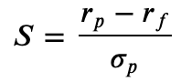
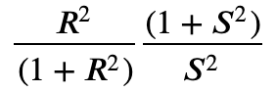
Problem Statement
I am a portfolio manager at a real estate investment fund
According to Campbell and Thompson (2008), small improvements in R² lead to large gains in investment performance, where expected gain =
S is the Sharpe ratio earned by a passive buy-and-hold investor
My goal is to use machine learning to improve the R² of my portfolio holdings of U.S. REITs.
R² = R-squared of portfolio

Slide 3
What are REITs
Real Estate Investment Trusts
Really boring stocks…typically owned by retirees or pension funds
need to give out >90% of their annual income (mostly rental yield)
this asset class tends to behave more like bonds than stocks,
Hence, REITS are typically ignored by financial literature

Slide 4
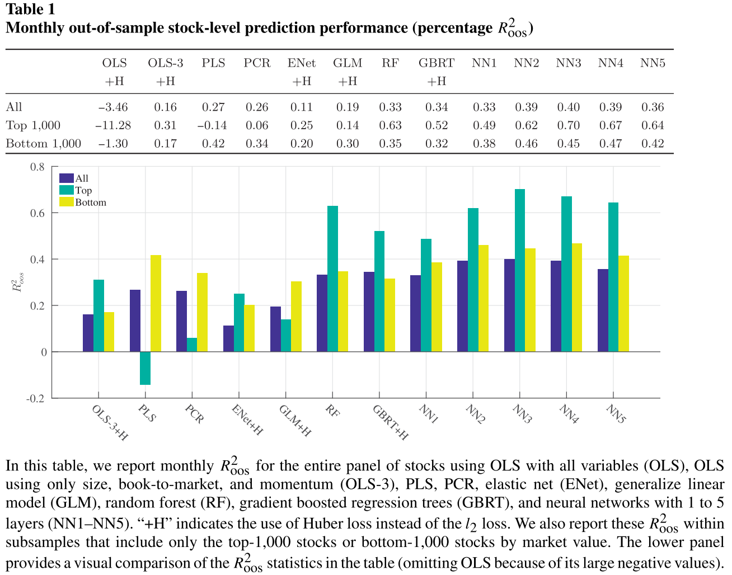
Empirical Asset Pricing and Machine Learning
Nascent subject in financial research
People don’t like ‘black box’ models that don’t understand
Gu, Kelly, Xiu (2020)

Slide 5
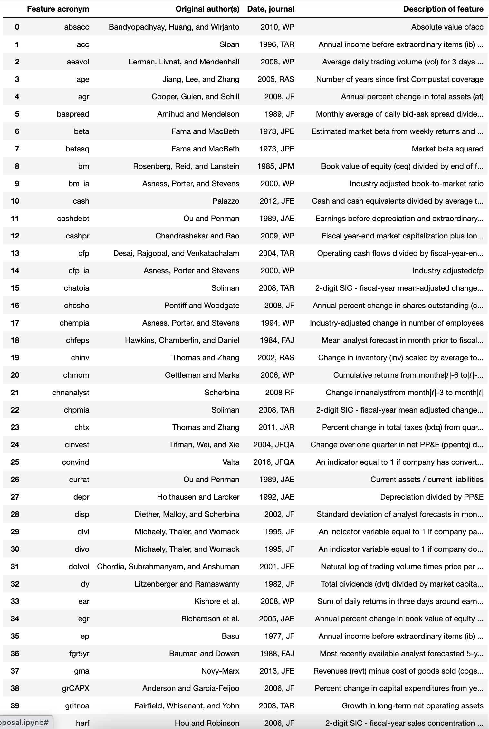
Modelling Approach
94 stock-level features
15 machine-learning models
Plenty of sweat, blood and pain
…including a total hard disk wipeout

Slide 6
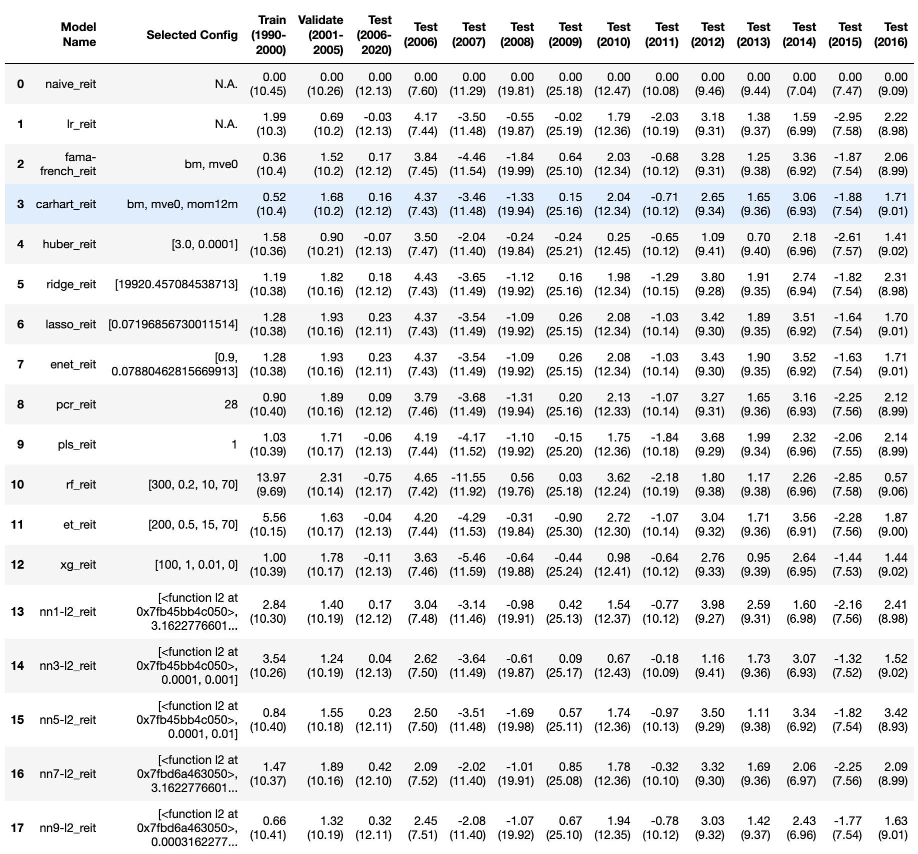
Results
Plain OLS can’t work…overfits
Tree regressors are worse
Regularized regression are better
Neural networks are the champs

Slide 7
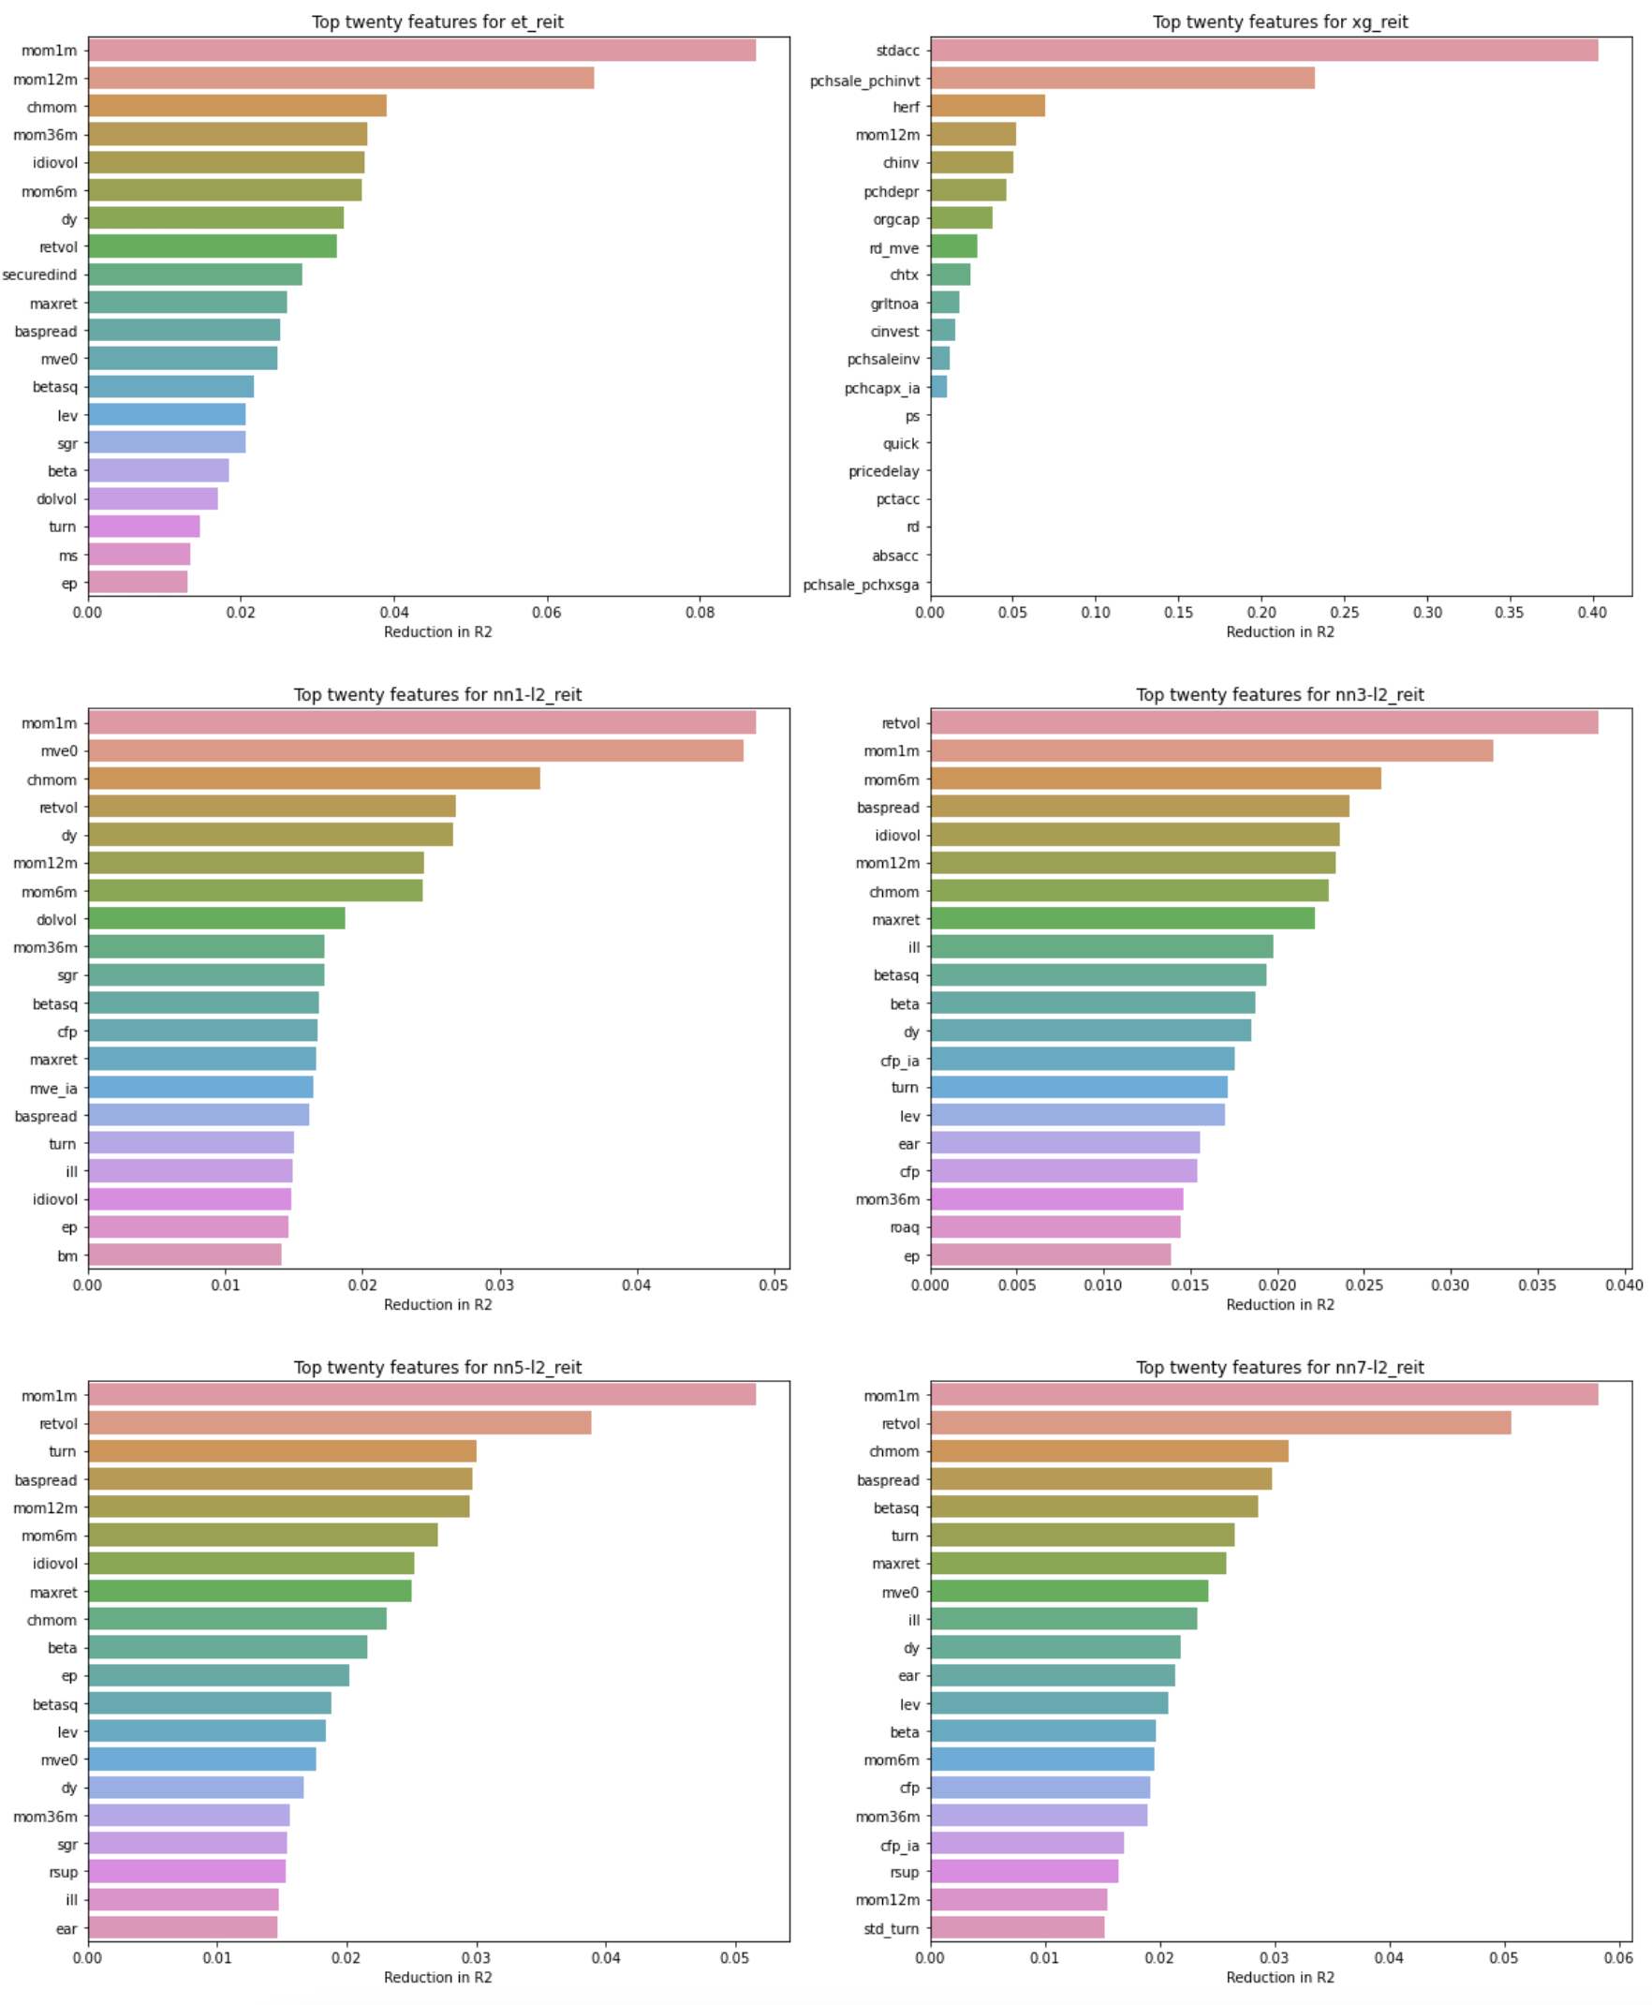
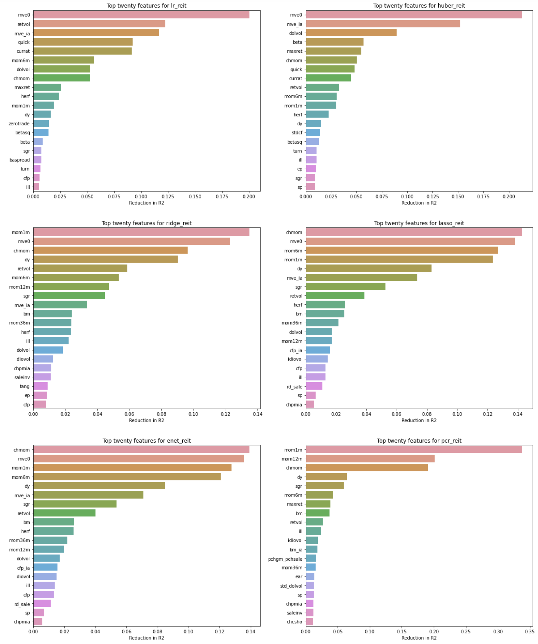
Features of importance
Features of importance are derived by looking at the difference in R² by setting the feature of interest to 0 (remember all features are already standard-scaled)
This allows ‘black box’ models such as Principal Component Regression and Neural Networks to be assessed on an equal footing with regression models such as OLS and Elastic Net
mve0, chmom, mom1mm mom12m, retvol, baspread seem to be the most common features of importance
Tree-based regressors have very different features of importance from other machine-learning models

Slide 8
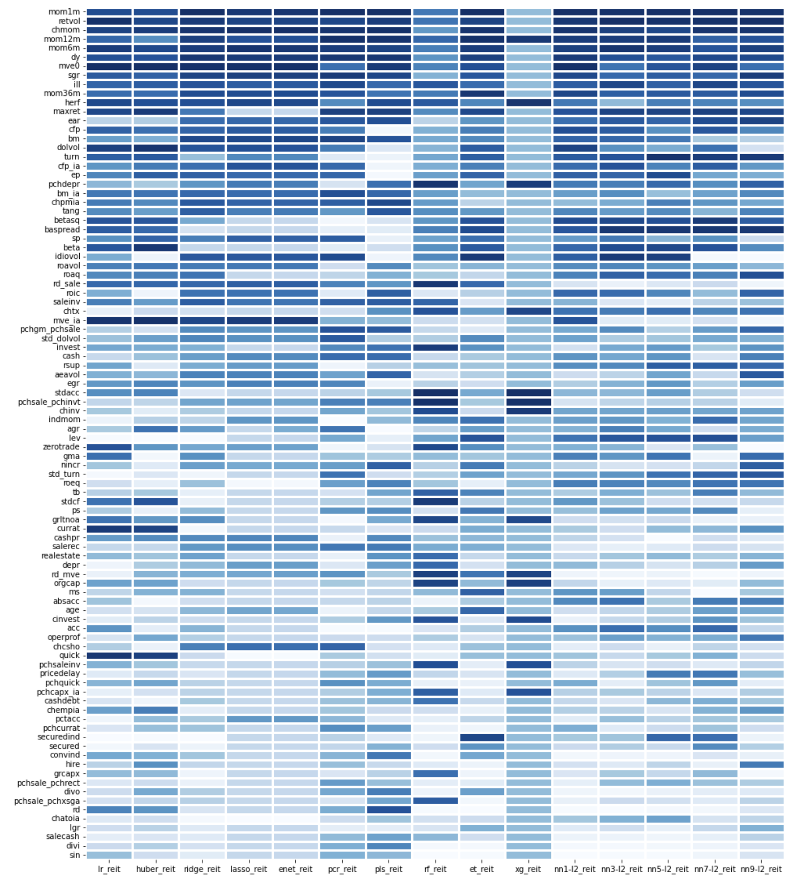
Features of importance
1-month momentum is the highest-ranked feature, on average across all models
Return volatility is next highest
Random Forest and XGBoost can’t make it…all important features for them contradict other models
Somehow, Extra Trees seem to agree with other models, even though its R² is negative

Slide 9
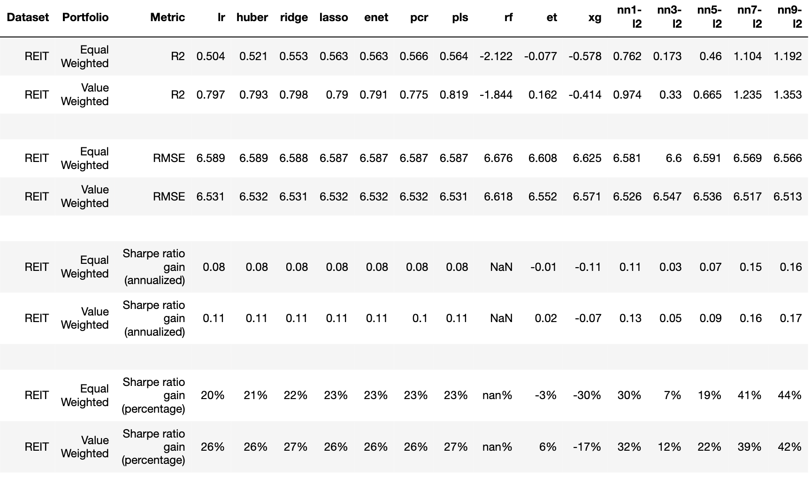
Portfolio Performance
Plain OLS is not too bad, despite overfitting at the stock-level
Tree regressors are terrible
Neural networks are the champs…even better on a portfolio level!!

Slide 10
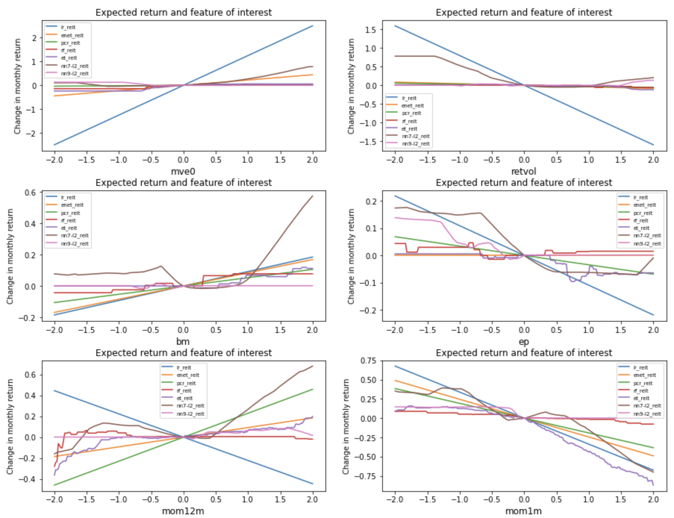
Marginal effects (Part 1)
Evident why regression models (OLS, Enet, PCR) can’t perform as well
Life is not so simple like a straight line
For example, traditional theory says that positive book-to-market ratios imply higher expected returns while negative ratios imply lower returns
However, neural networks says “chotto matte”…higher positive bm ratios may imply higher returns, but please ignore negative bm ratios

Slide 11
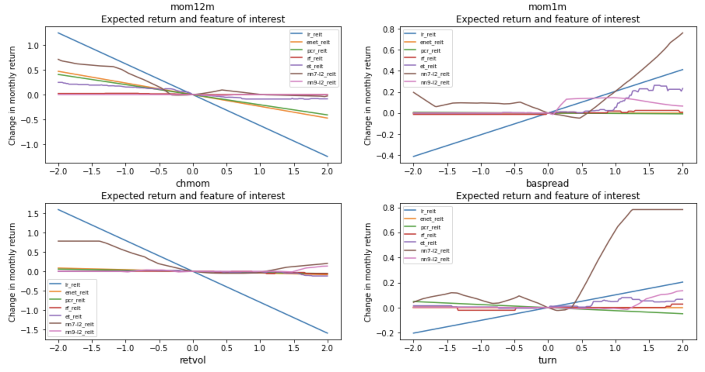
Marginal effects (Part 2)
Same for other variables
OLS say high volatility REITs imply lower expected returns and low vol REITs imply higher return
BUT… neural network say: ignore high vol REITs → no impact on returns… but low vol REITs imply higher returns

Slide 12
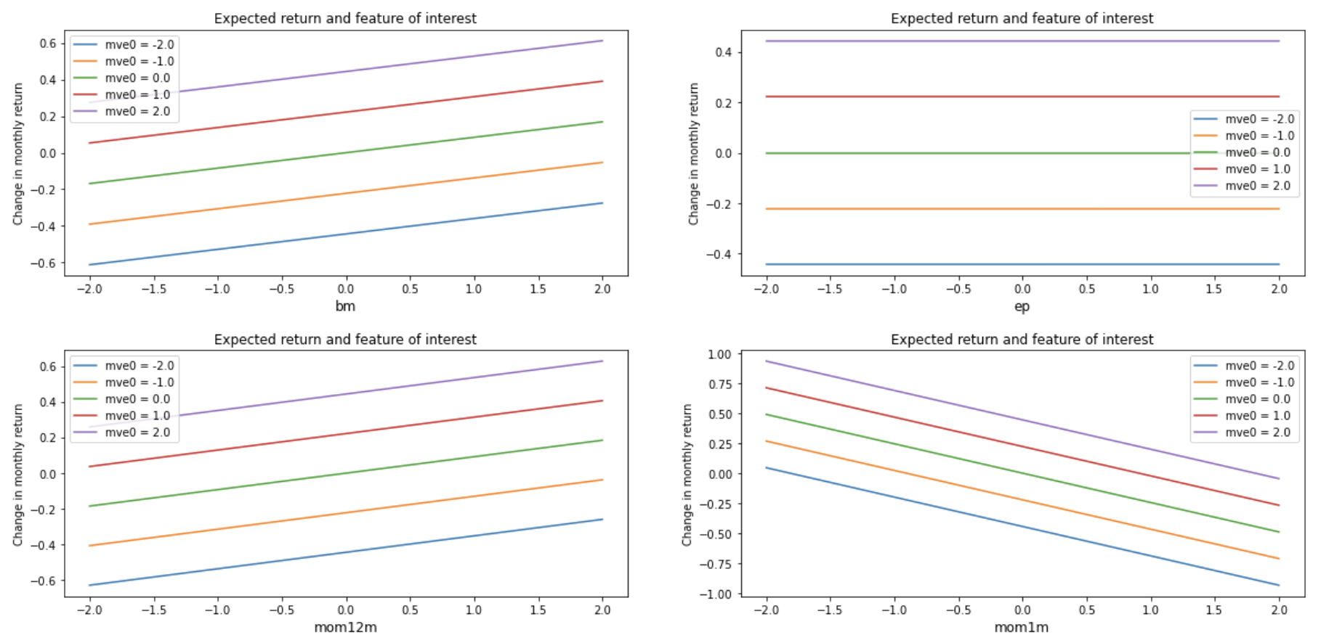
Interaction effects (Part 1)
The ability of neural networks to detect and capture non-linear predictive associations between expected returns and features is amazing
For example, NN7 is telling us to ignore 1-month momentum or earnings-to-price rations for the largest REITs if it is negative, but to consider it seriously if it is positive
A regression-based machine-learning model like Elastic Net has no choice but to impose a linear relationship across the entire spectrum of feature values, from negative to positive…
NN - 7 Layers
Elastic Net

Slide 13
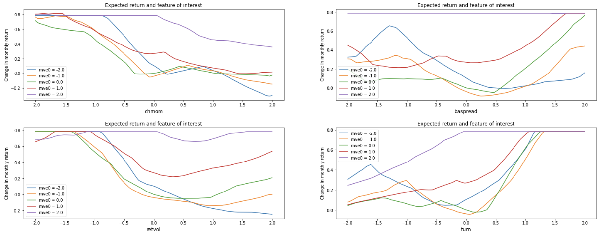
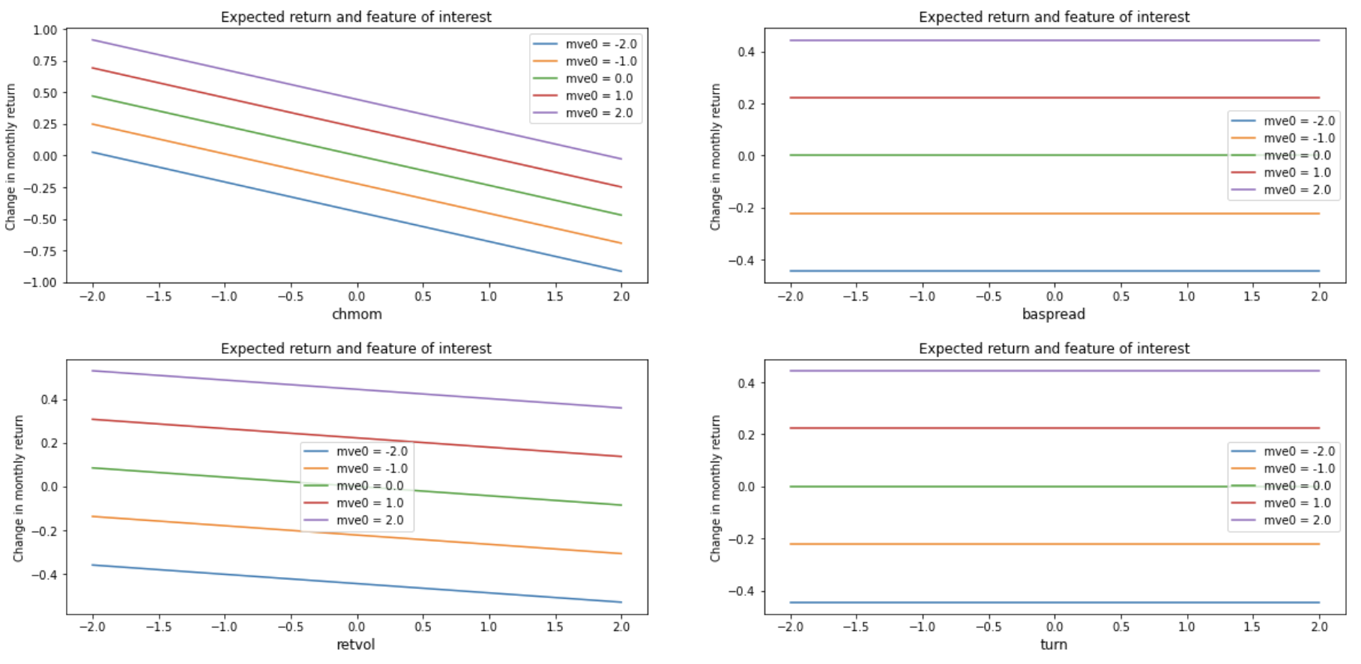
Interaction effects (Part 2)
Regression-based models are unable to deal with unordered behavior
For example, larger companies must always have higher effect on expected returns than smaller companies (purple is always higher than red, with blue at the bottom)
However, non-linear models like neural networks can accept that life is not so simple
When monthly trading volume turn is low, the smallest stocks should outperform largest stocks, but when trading volume is above average, large stocks will outperform small stocks
NN - 7 Layers
Elastic Net

Slide 14
Areas for improvement
Explore Recurrent Neural Network – Long Short Term Memory models
Explore Hierarchical Time Series Forecasting
Non-trivial to do it with panel data, but payoffs can be huge if one can figure out time-based cross-sectional predictive ability!

